Slide 2

Products

Slide 3
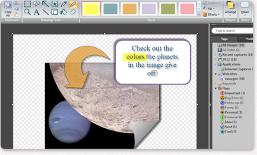






Snagit Overview
Screen capture software
With Snagit's easy-to-use tools, you can quickly create images and videos to give feedback, solve a problem, or show off something cool.
              Snag any image or video.
              Enhance it with effects such as callouts, arrows,
              and stamps.
              Save, share, or send your creations to anyone,
              anywhere!
              Some great sharing destinations include:

Slide 4
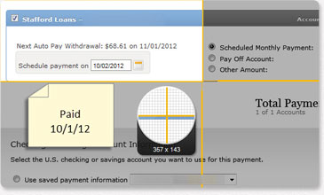
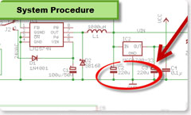

Snagit Uses
Snagit makes communication easier everywhere!
Business:
Education:
Home:
Video lessons & handouts
Research
Collaboration
Training
Communication & collaboration
Research & record keeping
Training
Documentation
Communication
Research
Record Keeping
And so much more!

Slide 5
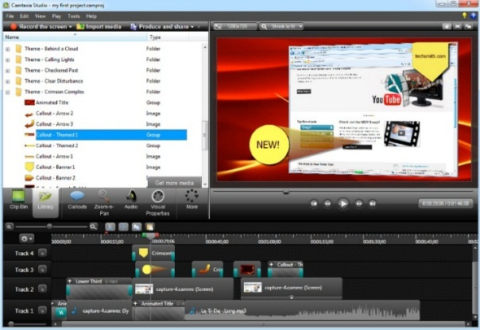
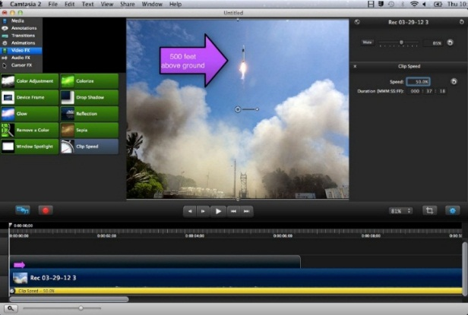
Camtasia Studio and Camtasia for Mac Overview
Screen recording and video editing software
With Camtasia’s flexible screen recording options, you can easily record your entire screen, a window, webcam video, a PowerPoint presentation, and more.
Capture smooth, high-quality videos.
Add imported media to personalize your videos.
Unleash your creativity with a variety of editing tools.
Produce professional videos without having to be a video pro.
Share high-quality, HD videos with anyone on nearly any device.
Camtasia Studio
Camtasia for Mac

Slide 6
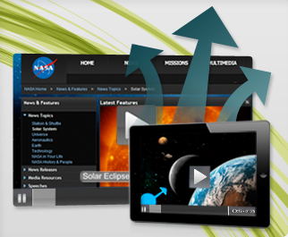
Camtasia Studio and Camtasia for Mac Uses
Camtasia is so easy, anyone can do it!
Record your screen to capture PowerPoint slides, software demos, webpages, and more.
Import existing camera video, images, and music to make your videos unique.
Edit your screen recordings and camera video by cutting, splicing, and combining clips.
Customize your screen recordings and videos with ready-to-use media themes, animated backgrounds, graphics, callouts, and more.
Produce interactive videos with clickable links, table of contents, search, and then share!

Slide 7
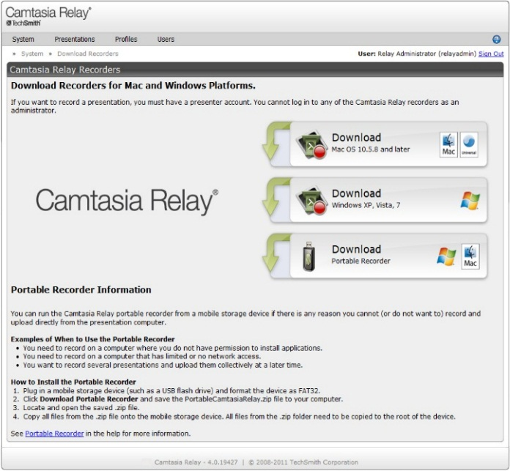
Camtasia Relay Overview
Presentation and lecture capture software
Easily record meetings, lectures, presentations, and more. Then publish them for anyone to watch. Camtasia Relay’s enterprise-wide screen recording makes all of the technical decisions at a central server, giving you a worry-free way to publish your presentations for anyone inside or outside your organization.

Slide 8

Camtasia Relay Uses
Using Camtasia Relay is as simple as pressing record.
With just three clicks, you can use Camtasia Relay’s presentation recording to capture and share your knowledge quickly.
Simply press record to capture audio, on-screen activity, and keyboard/mouse input during lectures, presentations, and meetings.

Slide 9

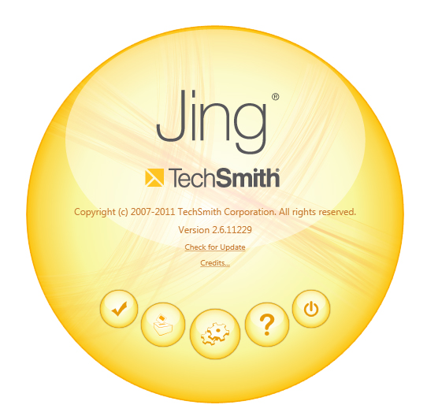
Jing Overview
Visual Communication
Simple and FREE, Jing is the perfect way to enhance your fast-paced online conversations. Create images and videos of what you see on your computer screen, then share them instantly!

Slide 10
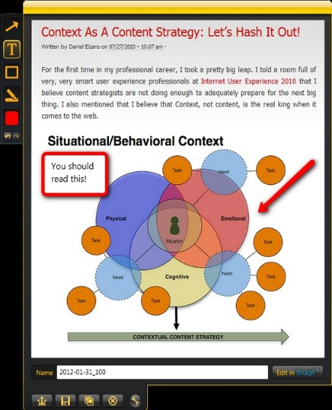



Jing Uses
Use Jing to share images and video.
Jing is a great tool for adding basic visual elements to all of your online conversations.
The Jing sun sits nicely on your desktop, ready to capture your screen at anytime. Jing will capture a window, pane, or region with just one click.
With Jing, you can add an image to your blog, or instantly share your captures through IM, email, and more!

Slide 11
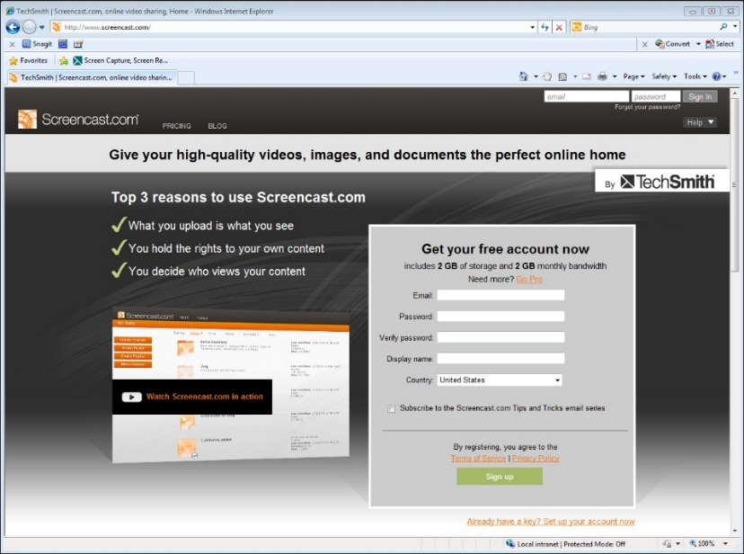
Screencast.com Overview
Video and content hosting
When you use TechSmith software to create great content, Screencast.com makes it possible to share it easily. You can post your captured images and videos to your Facebook, Twitter, or blog via the short URL or embed code Screencast.com gives you – saving time and avoiding the sharing runaround.

Slide 12
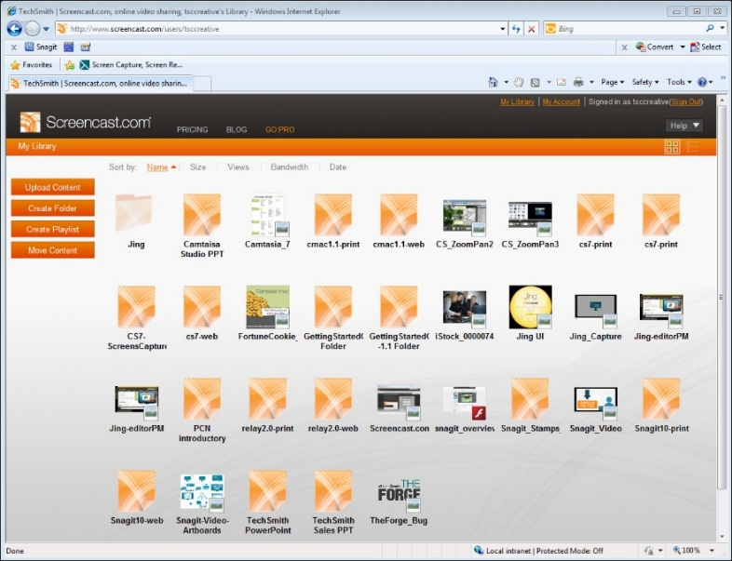
Screencast.com Uses
Use Screencast.com to...
Upload Jing and Snagit captures to the web and share them with a link.
Share your Camtasia videos online and control how private or public they are.
Share Morae usability testing videos with UX teams and stakeholders.

Slide 13
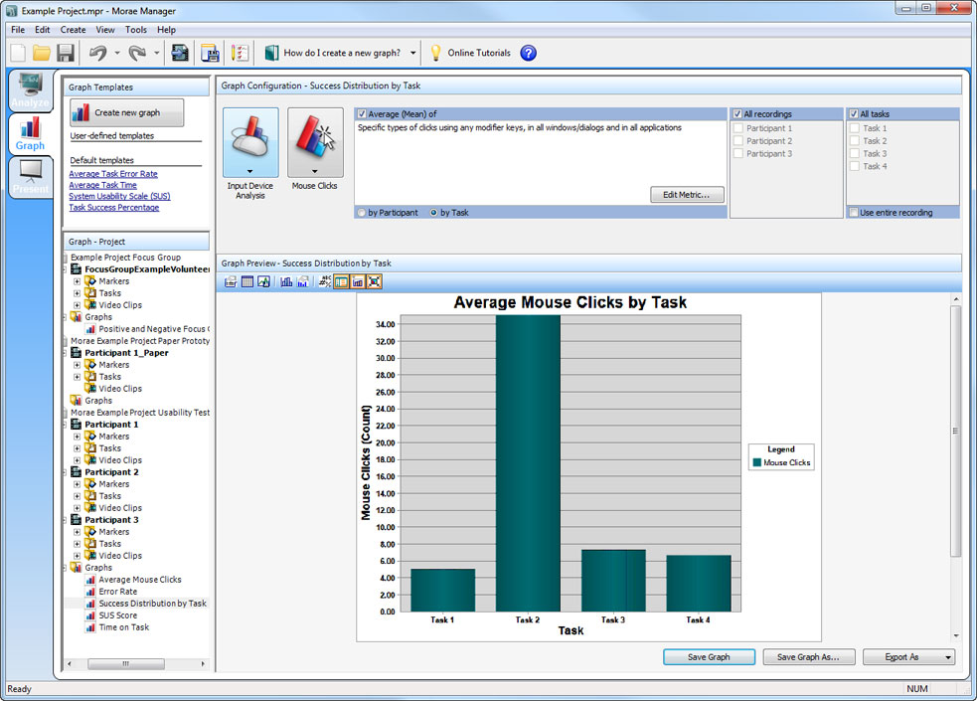
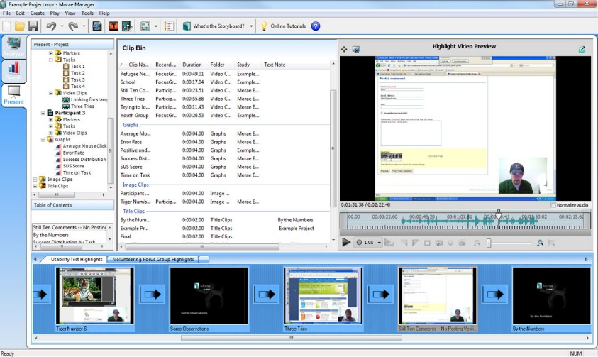
Morae Overview
Usability testing and market research software
Morae is a leading usability software that removes the guesswork from your decisions and helps you make products people love.
Record user interactions, efficiently analyze results, and instantly share your findings with anyone, anywhere.

Slide 14
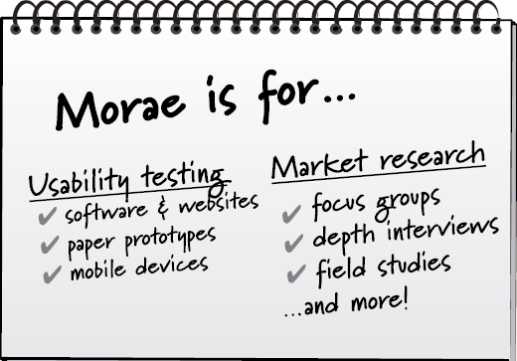
Morae Uses
Use Morae to...
Capture audio, on-screen activity, and keyboard/mouse input.
Watch people interact with your product, site, or idea.
Discover patterns and gain insight.

Slide 15

Coach’s Eye Overview
iPhone, iPad, and Android app
Whether you’re working on a golf swing, football drill, soccer kick, or yoga posture, Coach’s Eye delivers “ah-ha” moments that elevate athletes from good to great.
          Capture – Record a video of any sport or activity directly from your iOS or Android device.
          Analysis and Video Review – Immediately show your athletes what is happening by analyzing video in slow motion and calling out specific areas with lines and shapes.
          Share – Send your recordings to an athlete or entire team to help them improve their skills.

Slide 16
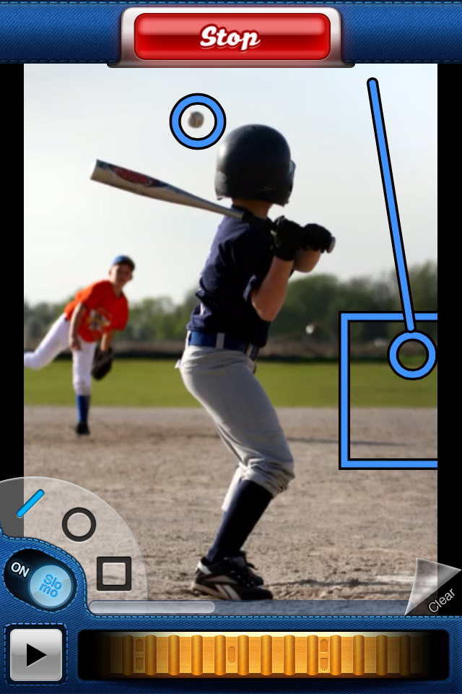
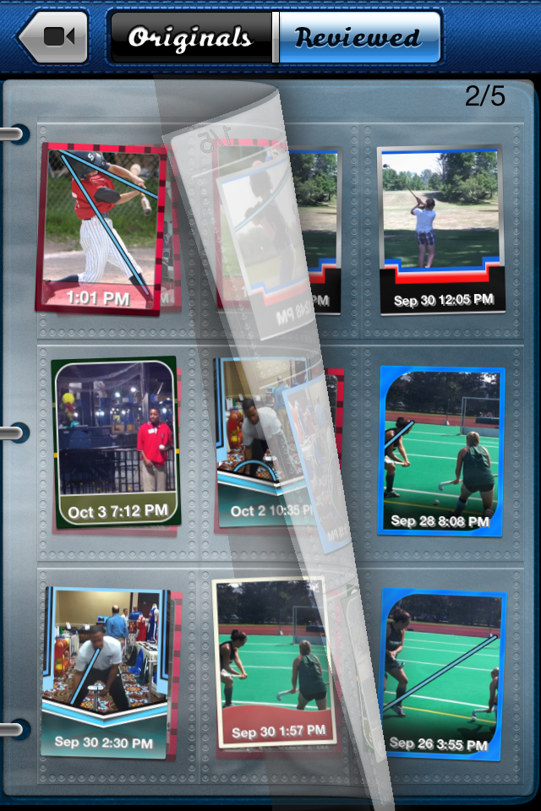
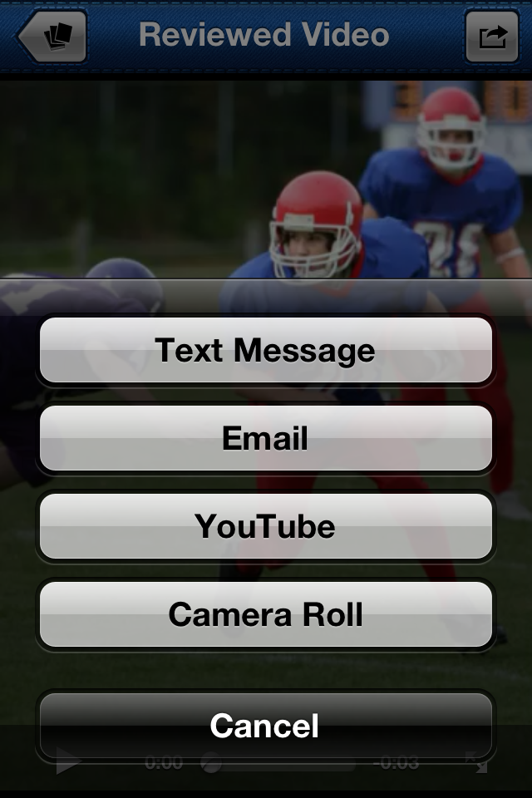
Coach’s Eye Uses
Instant video analysis and slow-motion review on your mobile device!
Instant Video Analysis
Slow Motion and Frame-by-Frame Scrubbing
Audio Voice Over and Drawing Tools
Share Your Wisdom

Slide 17
Contact Information
Visit us at http://www.techsmith.com/
To purchase products, please go to http://store.techsmith.com
Try any of our products for free at http://www.techsmith.com/download.html
For support, check out http://techsmith.custhelp.com/
And follow us by visiting the TechSmith blog, Facebook page, or Twitter page!
  http://blogs.techsmith.com/
  http://www.facebook.com/TechSmith
  https://twitter.com/TechSmith

